Slide 1
GLSL I
Ed Angel
Professor of Computer Science, Electrical and Computer Engineering, and Media Arts
Director, Arts Technology Center
University of New Mexico

Slide 2
Objectives
Shader applications
  Vertex shaders
  Fragment shaders
Programming shaders
  Cg
  GLSL
Angel: Interactive Computer Graphics 5E © Addison-Wesley 2009

Slide 3
Vertex Shader Applications
Moving vertices
  Morphing
  Wave motion
  Fractals
Lighting
  More realistic models
  Cartoon shaders
Angel: Interactive Computer Graphics 5E © Addison-Wesley 2009

Slide 4
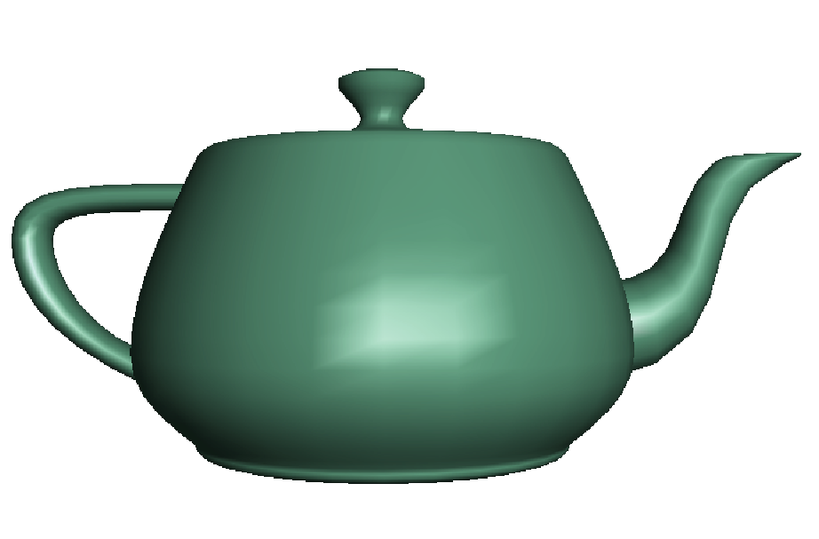
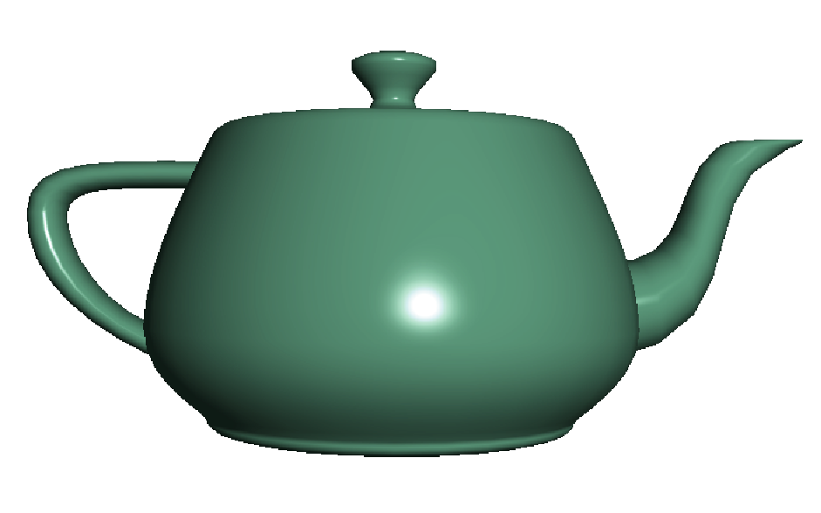
Fragment Shader Applications
Per fragment lighting calculations
per vertex lighting
per fragment lighting
Angel: Interactive Computer Graphics 5E © Addison-Wesley 2009

Slide 5



Fragment Shader Applications
Texture mapping
smooth shading
environment
mapping
bump mapping
Angel: Interactive Computer Graphics 5E © Addison-Wesley 2009

Slide 6
Writing Shaders
First programmable shaders were programmed in an assembly-like manner
OpenGL extensions added for vertex and fragment shaders
Cg (C for graphics) C-like language for programming shaders
  Works with both OpenGL and DirectX
  Interface to OpenGL complex
OpenGL Shading Language (GLSL)
Angel: Interactive Computer Graphics 5E © Addison-Wesley 2009

Slide 7
GLSL
OpenGL Shading Language
Part of OpenGL 2.0
High level C-like language
New data types
  Matrices
  Vectors
  Samplers
OpenGL state available through built-in variables
Angel: Interactive Computer Graphics 5E © Addison-Wesley 2009

Slide 8
Simple Vertex Shader
const vec4 red = vec4(1.0, 0.0, 0.0, 1.0);
void main(void)
{
gl_Position = gl_ProjectionMatrix
*gl_ModelViewMartrix*gl_Vertex;
gl_FrontColor = red;
}
Angel: Interactive Computer Graphics 5E © Addison-Wesley 2009

Slide 9
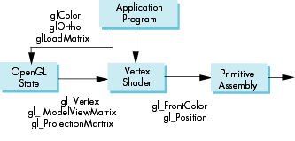
Execution Model
Angel: Interactive Computer Graphics 5E © Addison-Wesley 2009

Slide 10
Simple Fragment Program
void main(void)
{
gl_FragColor = gl_Color;
}
Angel: Interactive Computer Graphics 5E © Addison-Wesley 2009

Slide 11
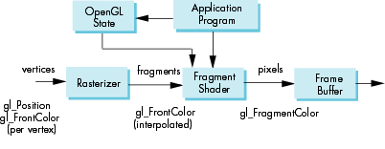
Execution Model
Angel: Interactive Computer Graphics 5E © Addison-Wesley 2009

Slide 12
Data Types
C types: int, float, bool
Vectors:
  float vec2, vec 3, vec4
  Also int (ivec) and boolean (bvec)
Matrices: mat2, mat3, mat4
  Stored by columns
  Standard referencing m[row][column]
C++ style constructors
  vec3 a =vec3(1.0, 2.0, 3.0)
  vec2 b = vec2(a)
Angel: Interactive Computer Graphics 5E © Addison-Wesley 2009

Slide 13
Pointers
There are no pointers in GLSL
We can use C structs which
can be copied back from functions
Because matrices and vectors are basic types they can be passed into and output from GLSL functions, e.g.
matrix3 func(matrix3 a)
Angel: Interactive Computer Graphics 5E © Addison-Wesley 2009

Slide 14
Qualifiers
GLSL has many of the same qualifiers such as const as C/C++
Need others due to the nature of the execution model
Variables can change
  Once per primitive
  Once per vertex
  Once per fragment
  At any time in the application
Vertex attributes are interpolated by the rasterizer into fragment attributes
Angel: Interactive Computer Graphics 5E © Addison-Wesley 2009

Slide 15
Attribute Qualifier
Attribute-qualified variables can change at most once per vertex
  Cannot be used in fragment shaders
Built in (OpenGL state variables)
  gl_Color
  gl_ModelViewMatrix
User defined (in application program)
  attribute float temperature
  attribute vec3 velocity
Angel: Interactive Computer Graphics 5E © Addison-Wesley 2009

Slide 16
Uniform Qualified
Variables that are constant for an entire primitive
Can be changed in application outside scope of glBegin and glEnd
Cannot be changed in shader
Used to pass information to shader such as the bounding box of a primitive
Angel: Interactive Computer Graphics 5E © Addison-Wesley 2009

Slide 17
Varying Qualified
Variables that are passed from vertex shader to fragment shader
Automatically interpolated by the rasterizer
Built in
  Vertex colors
  Texture coordinates
User defined
  Requires a user defined fragment shader
Angel: Interactive Computer Graphics 5E © Addison-Wesley 2009

Slide 18
Example: Vertex Shader
const vec4 red = vec4(1.0, 0.0, 0.0, 1.0);
varying vec3 color_out;
void main(void)
{
gl_Position =
gl_ModelViewProjectionMatrix*gl_Vertex;
color_out = red;
}
Angel: Interactive Computer Graphics 5E © Addison-Wesley 2009

Slide 19
Required Fragment Shader
varying vec3 color_out;
void main(void)
{
gl_FragColor = color_out;
}
Angel: Interactive Computer Graphics 5E © Addison-Wesley 2009

Slide 20
Passing values
call by value-return
Variables are copied in
Returned values are copied back
Three possibilities
  in
  out
  inout
Angel: Interactive Computer Graphics 5E © Addison-Wesley 2009

Slide 21
Operators and Functions
Standard C functions
  Trigonometric
  Arithmetic
  Normalize, reflect, length
Overloading of vector and matrix types
  mat4 a;
  vec4 b, c, d;
  c = b*a; // a column vector stored as a 1d array
  d = a*b; // a row vector stored as a 1d array
Angel: Interactive Computer Graphics 5E © Addison-Wesley 2009

Slide 22
Swizzling and Selection
Can refer to array elements by element using [] or selection (.) operator with
  x, y, z, w
  r, g, b, a
  s, t, p, q
  a[2], a.b, a.z, a.p are the same
Swizzling operator lets us manipulate components
  vec4 a;
  a.yz = vec2(1.0, 2.0);
Angel: Interactive Computer Graphics 5E © Addison-Wesley 2009

